Slide 1
Hydrocephalus
Meranthi Fernando
Dept of Paediatrics
25.01.2018

Slide 2
Outline
Define hydrocephalus
Background anatomy & physiology
Pathogenesis
Clinical features
Types of hydrocephalus
Aetiology
Investigations
Management
Complications
Differential diagnosis of large head

Slide 3
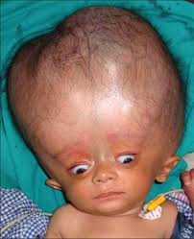
What is hydrocephalus?
Large head due to excessive accumulation of CSF with in the ventricular system
Not a specific disease
It is a manifestation of an underlying disease

Slide 4
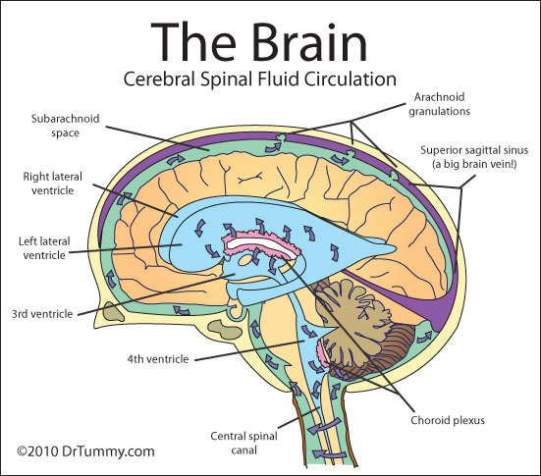

Slide 5
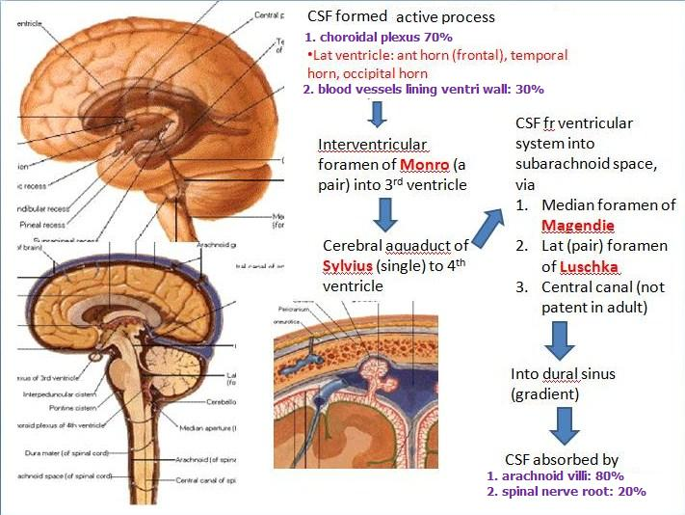

Slide 6
Pathogenesis of hydrocephalus
Increased production of CSF
Eg: choroid plexus papilloma
Impaired absorption of CSF
Eg:
Sub arachnoid h’ge
Meningitis
Impaired circulation of CSF
Eg:
Aqueductal stenosis
Chari malformation – type II
Dandy- Walker malformation
Space occupying lesion
tumours, haematomas, abscesses

Slide 7
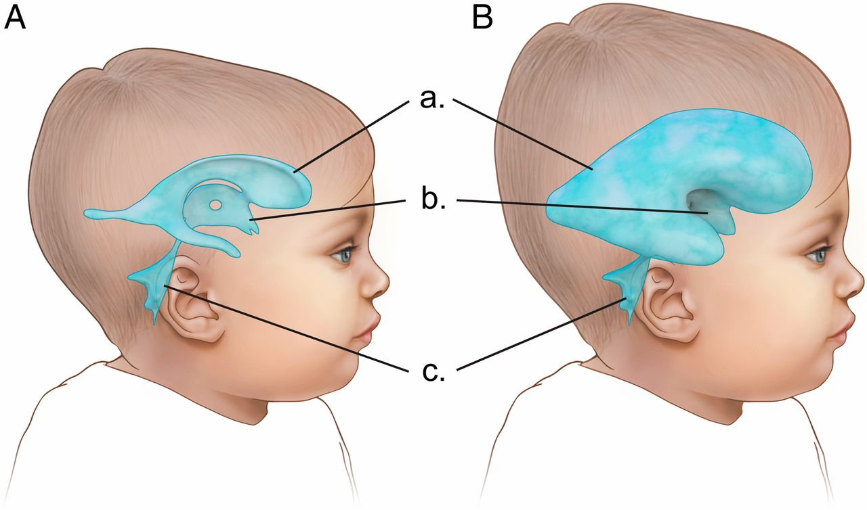
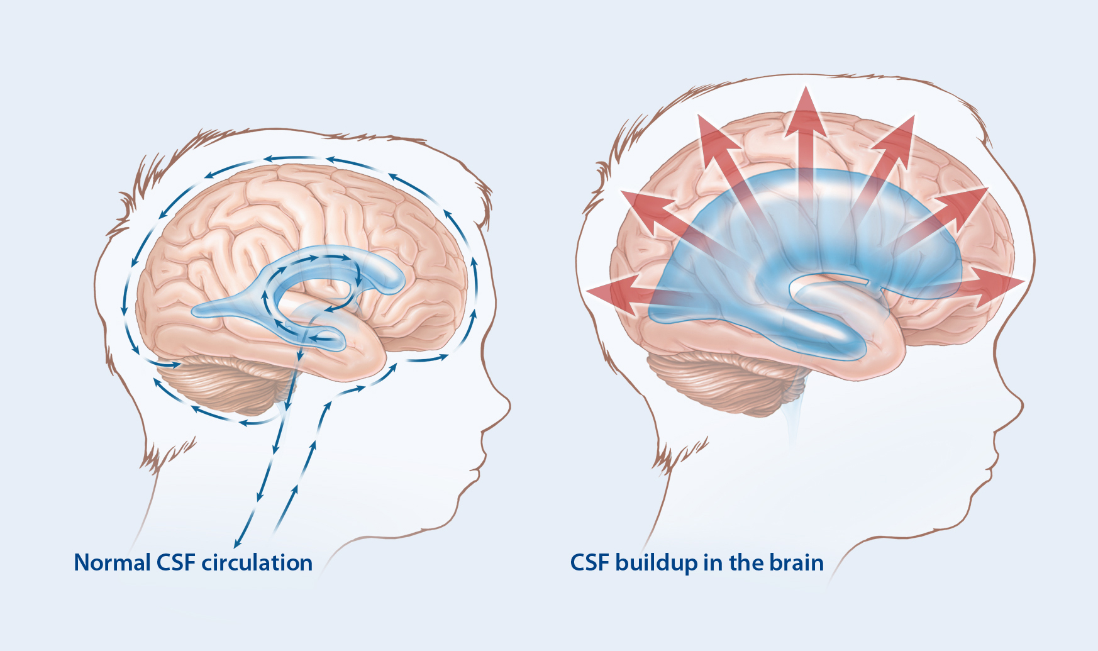
Hydrocephalus

Slide 8
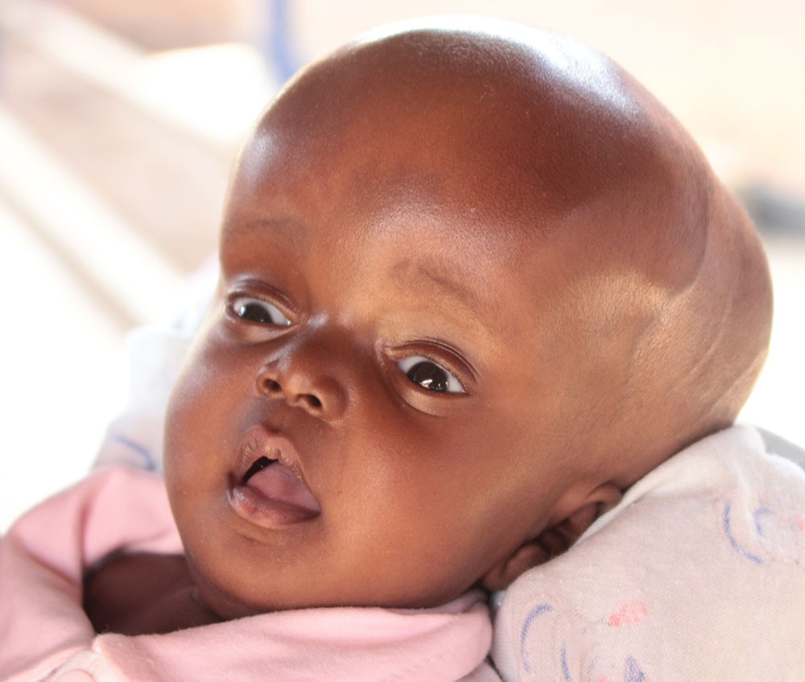
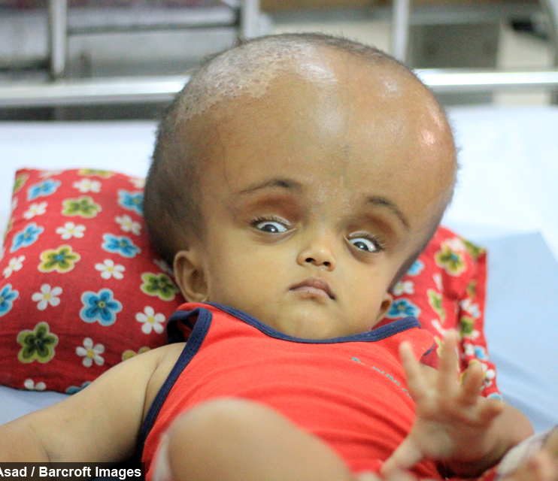
Clinical features

Slide 9
Clinical features
Depend on the age of onset and underlying cause , rate of rise in intra cranial pressure
Signs in the head and face
Other signs
General
Large head / Unduly rising OFC
Frontal bossing
Broad forehead
Dilated veins over the scalp
Setting-sun sign mechanism??
Deeply set eyes
Wide anterior fontanelle and bulging
Suture separation
Macewen sign – cracked pot sign
Long tract signs
Brisk tendon reflexes
Spasticity
Clonus
Babinski sign
Papilledema
6th nerve palsy
Signs suggestive of occult spinal dysraphism
Nausea
Vomiting
Drowsiness
Headache
Irritability
Lethargy
Poor appetite
Change in personality
Deterioration of academic performance

Slide 10
Types of hydrocephalus
Hydrocephalus
Acquired
Non communicating (obstructive )
Communicating
Congenital

Slide 11
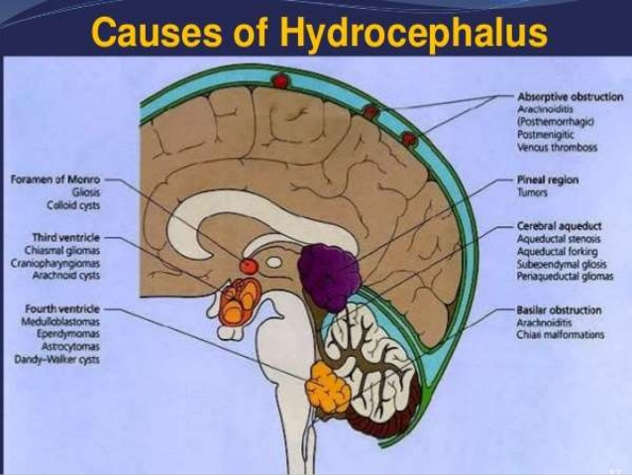

Slide 12
Causes of hydrocephalus
Communicating
Non communicating
Meningeal malignancy , leukemic infiltrates
Meningitis
Post-haemorrhagic
Achondroplasia
Basilar impression
Benign enlargement of subarachnoid space
Choroid plexus papilloma
Aqueductal stenosis
Neural tube defects
Infectious – congenital infections
Mass lesions – brain tumours specially posterior fossa
Abscess
Haematoma – SAH, Intraventricular haemorrhage in preterm infants
X linked/Mitochondrial/Autosomal recessive/Autosomal dominant
Arnold Chiari malformations & Dandy-Walker malformations
Klippel-Feil syndrome

Slide 13
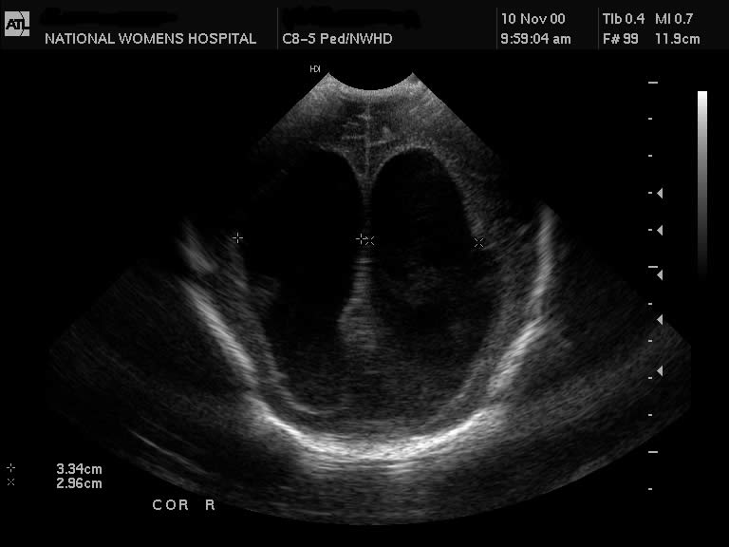
Investigations – USS brain

Slide 14
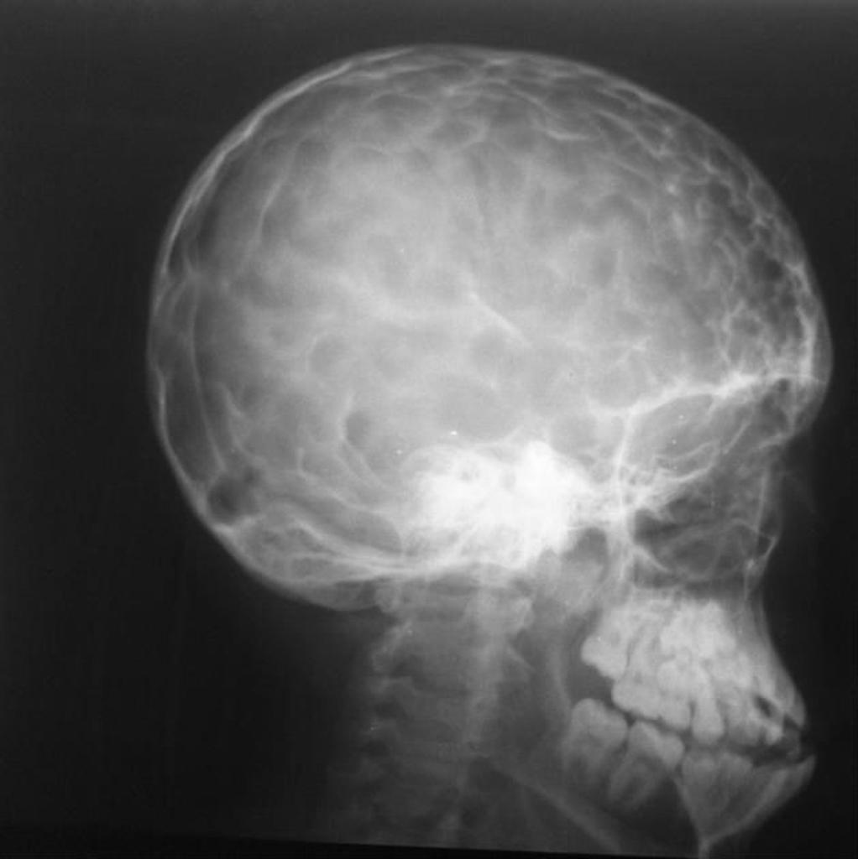
Investigations - X ray skull
Separation of the sutures
Erosion of the posterior clinoids
Silver-beaten appearance – indicate long standing raised ICP

Slide 15
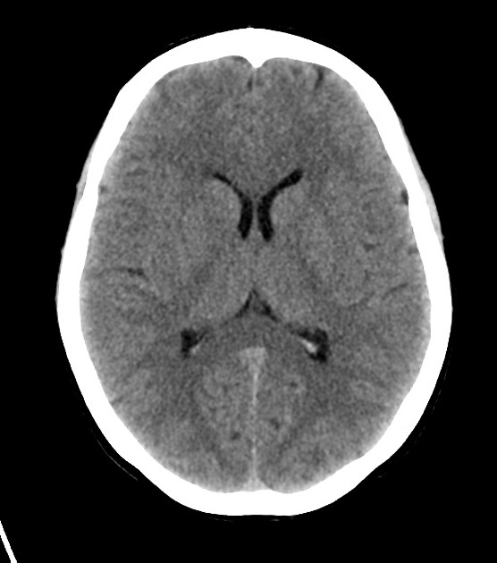
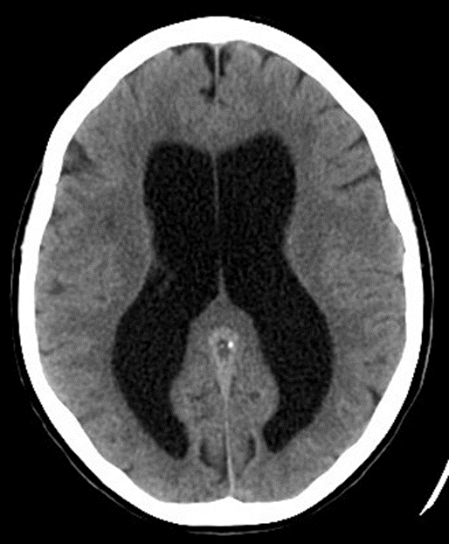
Investigations – CT brain

Slide 16
Management of hydrocephalus
Depend on the underlying aetiology
However, raised ICP is a medical emergency which should be managed according to a common protocol
Conservative management
(arrested hydrocephalus or under control with shunts)
Monitor OFC
Monitor development
Medical management
Acetazolamide
Surgical management
Internal CSF drainage eg: VP shunt
Monitor for neurological symptoms
External CSF drainage
Furosemide

Slide 17
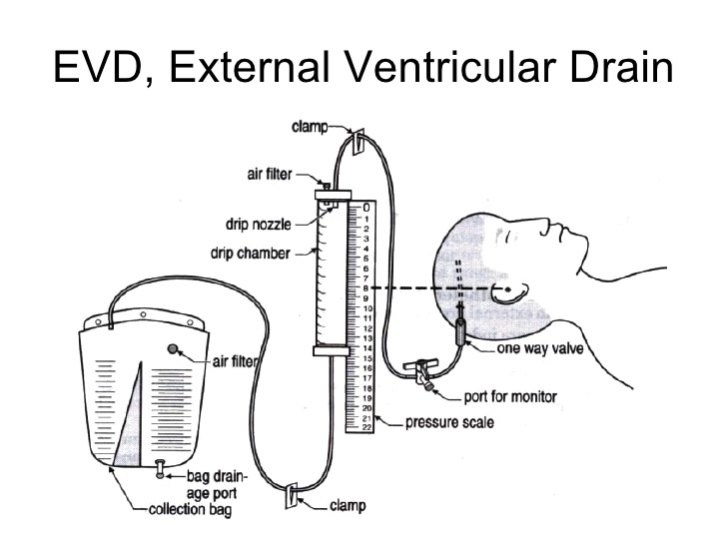
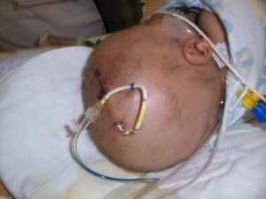

Slide 18
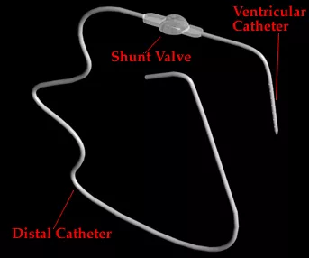
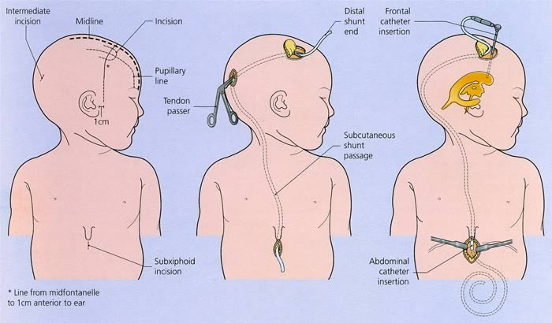
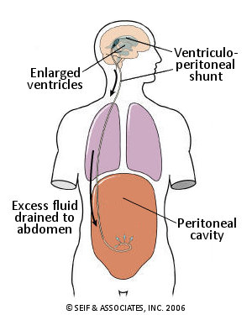
Ventriculo-peritoneal shunt

Slide 19
Complications of hydrocephalus
Increased intra-cranial pressure
Vomiting
Rapid rise in OFC
Drowsiness
Seizures
Developmental delay
Low IQ
Visual Problems
Strabismus
Field defects
Optic atrophy
Precocious puberty
Epilepsy

Slide 20
Complications of shunts
Shunt occlusion
Shunt infection- usually due to staphylococcus epidermidis
Over drainage of CSF
Ventriculitis
shunt malfunction, shunt failure - disconnected, displaced, becomes blocked, infected or it is outgrown
Shunt nephritis – commonly with VA shunts

Slide 21
Differential diagnoses of large head
Hydrocephalus
Hydranencephaly
A condition in which the brain's cerebral hemispheres are absent to varying degrees and the remaining cranial cavity is filled with cerebrospinal fluid
Megalencephaly (familial, metabolic and degenerative disorders in CNS)
Thickened cranium (Chronic anaemia, rickets, osteogenesis imperfecta)
Familial

Slide 22
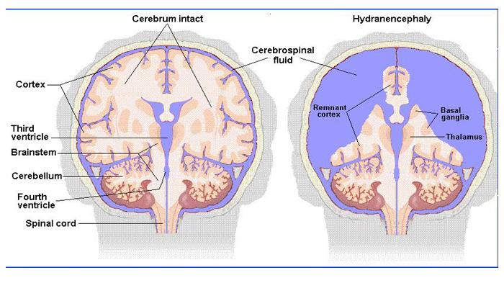
Hydrocephalus vs hydranencephaly

Slide 23
Extended learning
https://youtu.be/-enG4vCVw6U

Slide 24


